Slide 1

Version Control

Slide 2
Why do we need Version Control
Maintaining group Projects
Patches are mostly sent via email
Difficult to roll back
Almost impossible to maintain if the number of people working in the project is large
Testing new unstable features

Slide 3
Version Control: Why?
Individual
Back-ups of the project
Create a “checkpoint” in the project at any stage: Fearlessly modify code
Tagging: Mark certain point in time
Branching: Release versions and continue development
Team
Everything in “Individual”
Allow multiple developer to work on the same codebase
Merge changes across same files: handle conflicts
Check who made which change: blame/praise

Slide 4




Introduction
A method for recalling versions of a codebase
Keeping a record of changes
Who did what and when in the system
Save yourself when things inevitably go wrong

Slide 5
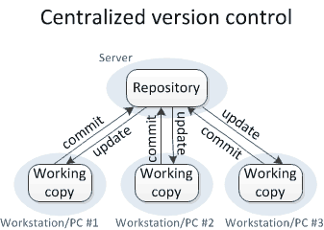
Version control Types
Centralised VCS
A single authoritative data source (repository)
Check-outs and check-ins are done with reference to this central repository

Slide 6
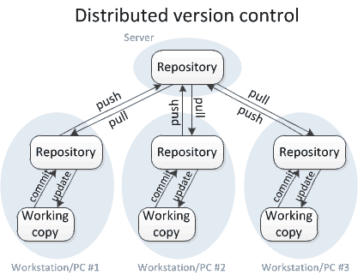
Version control Types
Distributed VCS
No single repository is authoritative
Data can be checked in and out from any repository
Git
Mercurial

Slide 7
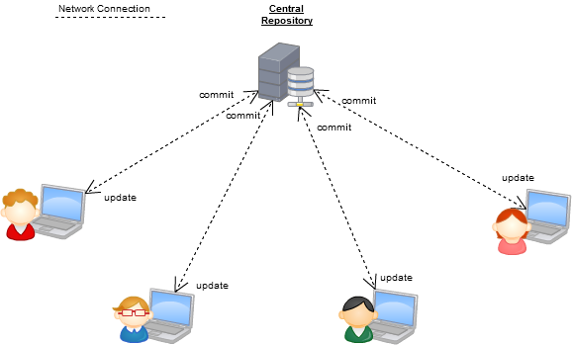
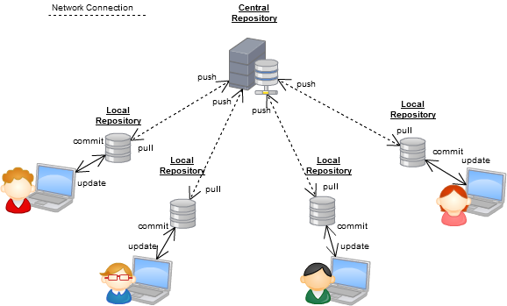
Version control Types

Slide 8

Git History
Came out of Linux development community
Linus Torvalds, 2005
Initial goals:
Speed
Support for non-linear development (thousands of parallel branches)
Fully distributed
Able to handle large projects like Linux efficiently
Global Information Tracker (acronym name)

Slide 9

Git
Free, open source
Fully distributed
Handle small files very effectively
Tracks contents, not files
Data = Snapshot
No network
Three stages
Created by Linus Torvalds in less than 2 weeks

Slide 10
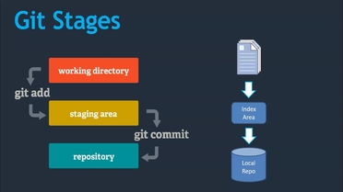
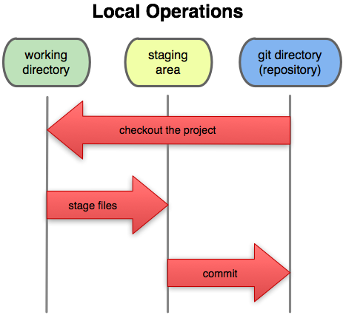
Git Stages
Working directory
Staging directory
Git directory (repository)

Slide 11
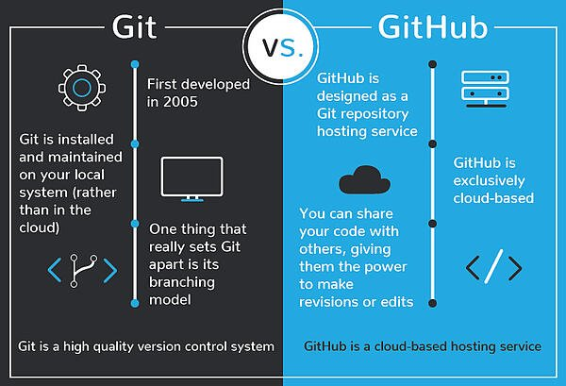
Git Vs GitHub

Slide 12
Git commands
command | description
git clone url [dir] | copy a git repository so you can add to it
git add files | adds file contents to the staging area
git commit | records a snapshot of the staging area
git status | view the status of your files in the working directory and staging area
git diff | shows diff of what is staged and what is modified but unstaged
git help [command] | get help info about a particular command
git pull | fetch from a remote repo and try to merge into the current branch
git push | push your new branches and data to a remote repository
others: init, reset, branch, checkout, merge, log, tag

Slide 13
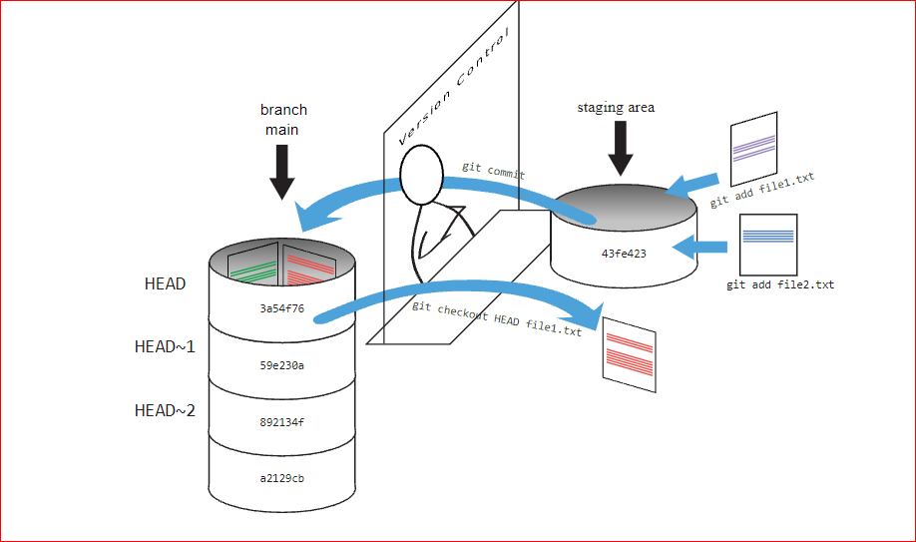
Git Process

Slide 14
Git Tools
Windows Git Clients:
Sourcetree
GitHub for Windows .
Tortoise Git
Mac Git Clients:
GitUp
GitBox
Git-Xdev

Slide 15

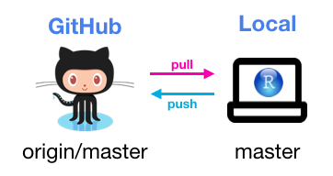
Summary

Slide 16


Thank You
Shruti Wali

